Slide 1
People DImensIon
IS 739 Information Systems in Organizational Design and Applied Systems Thinking
Merve Vildan ŞİMŞEK

Slide 2
Introduction
Ways for Management of People
Firm size
Professionalization
People Management Approaches
Shop
Factory
Laboratory
Office
Diagnostic Questions
Fits & Misfits
Notes:
Discuss two factors for management of people and describe four approaches
Then answer to diagnostic questions.
Lastly determine fits and misfits

Slide 3
Why we need an organization?
Individuals are limited to process information
Boundedly rational
Becoming an organization is one of the solutions.
Effective «management of people» is a must to reach the goals in organizations.
Notes:
Why we need an organization?
People are limited to process information that is also called boundedly rational.
There is a way to overcome that limitation. Becoming an organization is one of the solutions.
Effective «management of people» is a must to reach the goals in organizations.
From an organizational design perspective the important question for the executive is: what is the best way to manage people, given the organization’s goals, strategy, structure, and task design?

Slide 4

Number of people
It refers to firm size
Includes the total number of people
Full time
Part time
Temporary
Volunteer
Notes:
How many people work in the company?

Slide 5
Professionalization
People generate information
Professionalization is increased by
Education, training and experience
Knowledge should be shared with the organization to meet efficiency and effectiveness
Explicit knowledge can be documented
Tacit knowledge requires social interaction
Notes:
Professionalization is the collective skill level of the individuals and a measure of their capabilities for the work that they do.
People generate information when they work
Professionalization is affected by
Education, training and experience
Professionalization brings knowledge that should be shared with the organization to meet efficiency and effectiveness
Explicit knowledge can be documented
Tacit knowledge requires social interaction

Slide 6
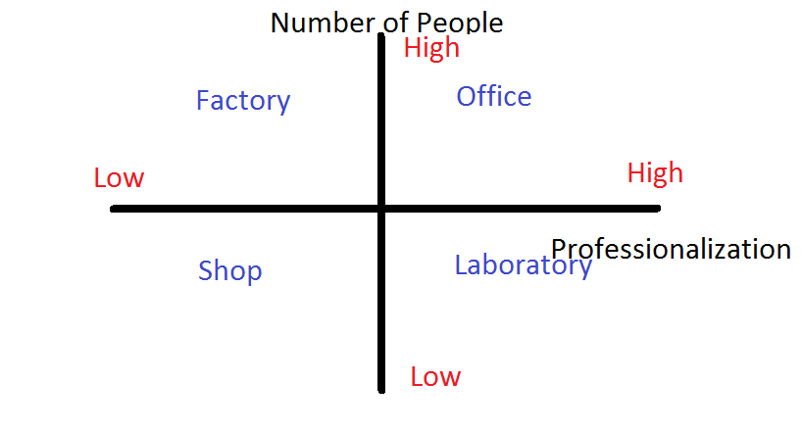
People Management Approaches
Notes:
This is the people space diagram
2 dimensions: professionalization on the horizontal axis and the number of individuals on the vertical axis
There are four general approaches for people management.
We will now look into each of the four categories.

Slide 7
1. Shop approach
involves employing a few people
coordination requirements are low
who are low on professionalization
a few days training
Information processing capacity is low
Routines are simple
The manager should direct people strictly
Focused on neither efficiency nor effectiveness
E.g.: small stores
Notes:
Few people are employed with low on professionalization
Routines should be simple with only few steps: they must be easily understood and easy to learn.

Slide 8
2. Factory approach
involves employing many people
coordination requirements are high
who are low on professionalization
tasks can be executed repetitively
a few days training
Information processing capacity of the employees is low
The manager should direct people strictly
Focused on efficiency
E.g.: assembly line, call center and large hotel
Notes:
Many people are employed with low professionalization
Their work tasks can be executed repetitively, so Routines are relatively simple.

Slide 9
3. Laboratory approach
involves employing a few people
coordination requirements are low but motivation
who are high on professionalization
comes from extensive education, training, and experience
Tacit knowledge rather than routines
Manager supports worker rather than strictly supervisions
Focused on effectiveness and high quality
E.g.: University, financial research group, and hi-tech software design group
Notes:
Few people are employed with high professionalization
Each one can work alone and the manager’s job is to support the individual
Tacit knowledge rather than routines: workers coordinate in small groups for intense information sharing

Slide 10
4. Office approach
involves employing many people
coordination requirements are high
information processing demand is high
who are high on professionalization
comes from extensive education, training, and experience
Tacit knowledge rather than routines
Manager supports worker rather than strictly supervisions
Focused on both effectiveness and efficiency
E.g.: construction and pharmaceutical firms
Notes:
Many people are employed with high professionalization
Need for coordination is high. Due to the large number of people to manage.

Slide 11
Diagnostic Questions
1. Choose a unit
2. Number of individuals?
1 = Less than 100 employees
2 = 100 - 500 employees
3 = 501 - 1000 employees
4 = 1001 - 2000 employees
5 = More than 2001 employees
3. Professionalization?
%10=1, %11-20=2, %21-50=3, %51-75=4, %76-100=5
4. Locate the firm
Notes:
We should examine the two dimensions for a firm and locate the firm two dimensional people space diagram.
First step is
1. Choosing a unit to analyse
2. How many people are there in the firm?
3. How many people have advanced university degree or high experience?
4. Let’s locate the firm

Slide 12
Example
Academic Status | Number of | Percentage
PhD. | 4 | %6.5
MSc. | 29 | %47.5
BSc. | 28 | %46
61 people (all of them are educated)
33 people are highly educated(%54)

Slide 13
Example Approach
X

Slide 14
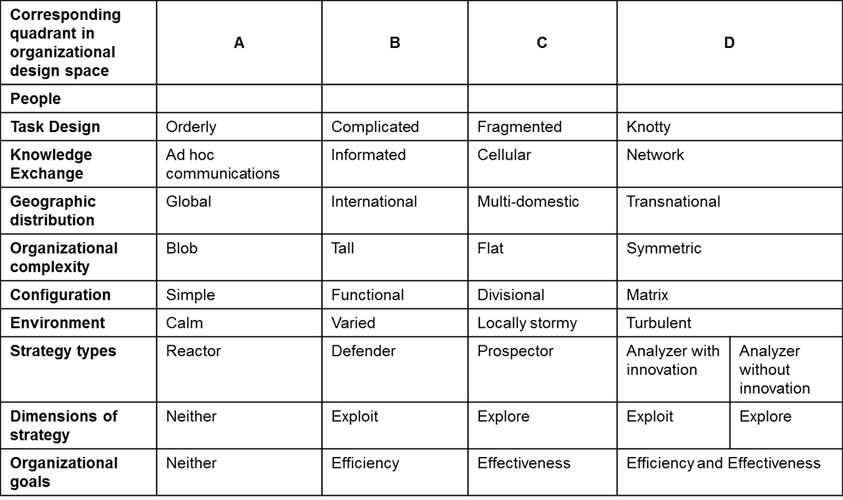
Fits & Misfits
Notes:
The table summarizes the four columns in the organizational design space introduced thus far.
Misfits are any set of relations that do not matches with one column.
Size of the firm or their professionalization level bring misfits.

Slide 15
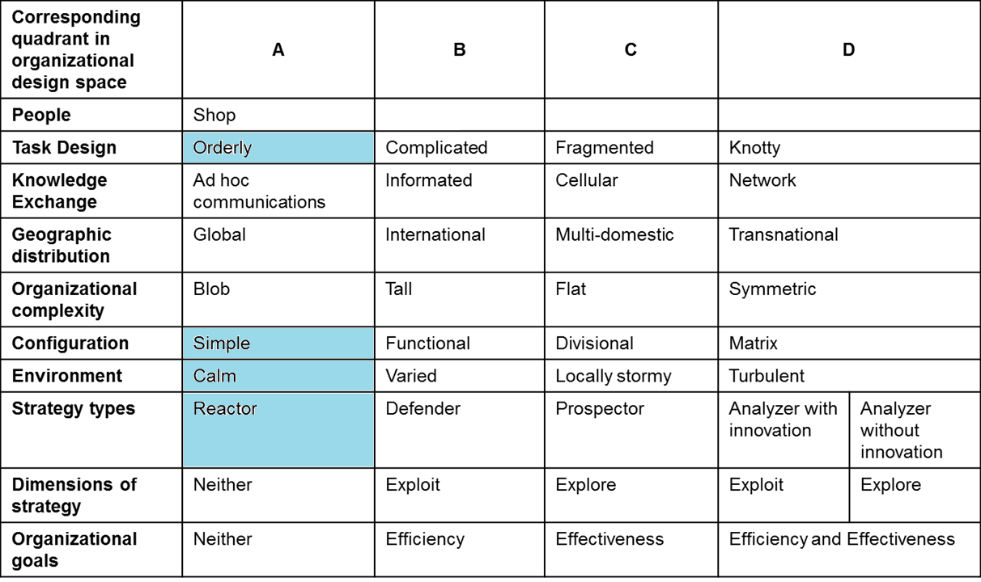
Fits & Misfits
Notes:
For column A, there is a fit for the shop with a reactor strategy, a calm environment, a simple configuration, and orderly task design
However if the environment becomes more uncertain and requires changes, it is very likely that the nonprofessional people will either resist change or lack the skills for change. It is a potential misfit for example.

Slide 16
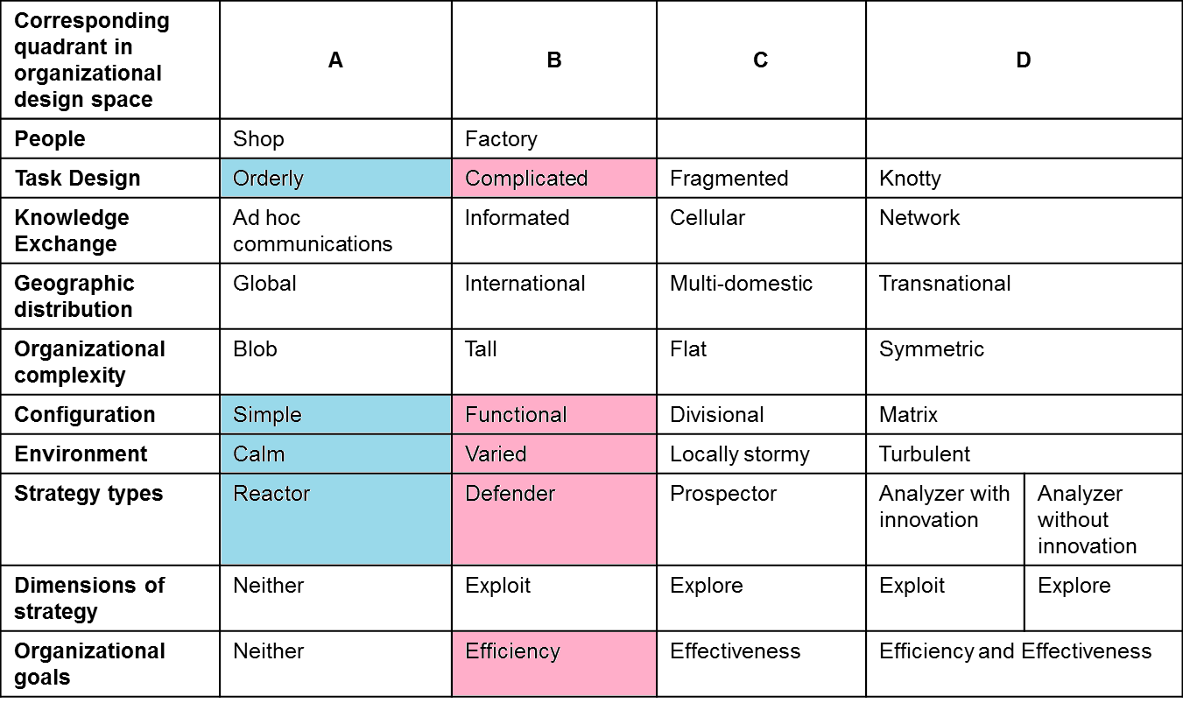
Fits & Misfits
Notes:
Moving to B, the factory is a fit for an efficiency goal, defender strategy, varied environment, a functional configuration, and a complicated task design.
However, if the environmental unpredictability increases and thus requires additional information processing, then the functional configuration is not suited to make changes quickly. In such a misfit situation, the individuals will require greater professionalization.

Slide 17
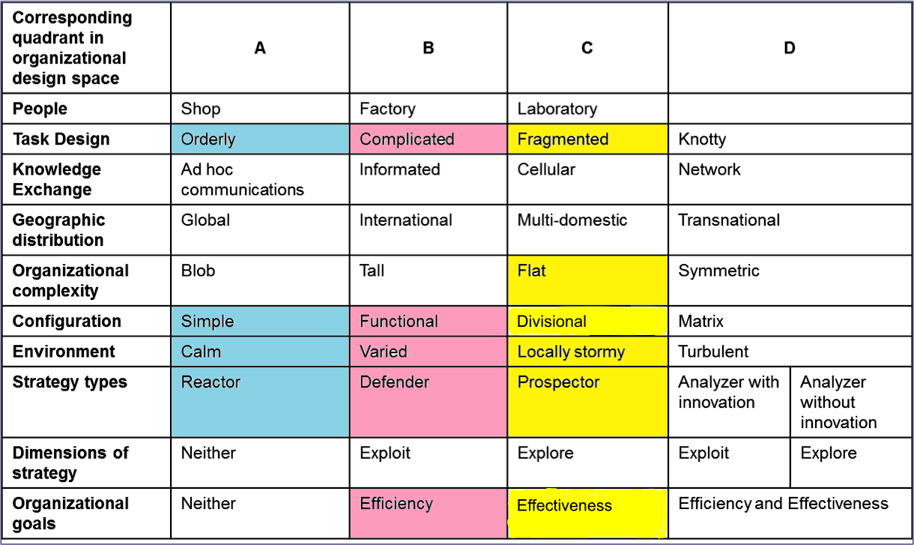
Fits & Misfits
Notes:
For column C, the laboratory is a good fit for: a flat complexity, a divisional configuration, a locally stormy environment, a prospector strategy, and an effectiveness goal.
The executive can create independent divisions to deal with the local conditions. Each division has its own environment which is stormy but largely independent of the others. As the number of subunits increases, the coordination issues will become problematic and will eventually create a misfit.

Slide 18
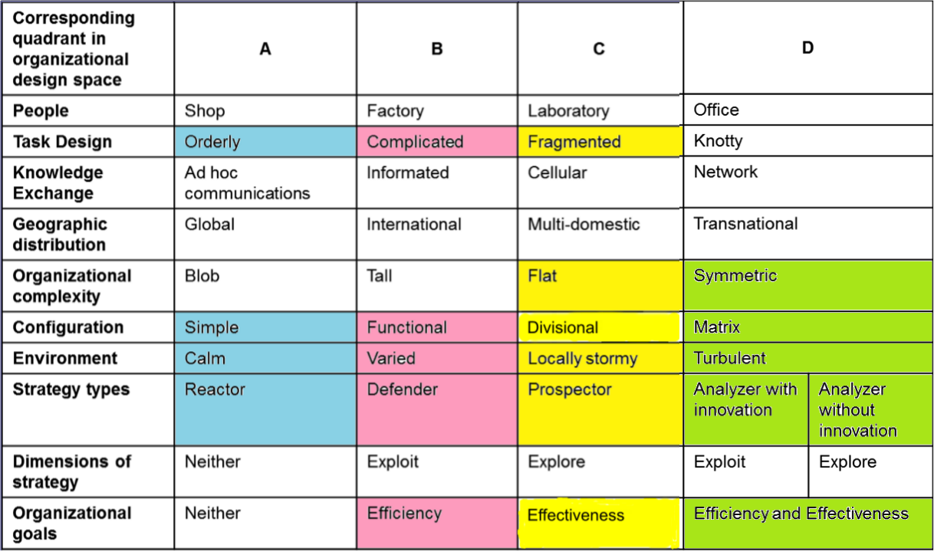
Fits & Misfits
Notes:
For column D, the office is a fit for a symmetric complexity, a matrix configuration, a turbulent environment, an analyzer strategy and dual goals.
Firms that have more characteristics in the same column are said to have good fit.
.

Slide 19
“An enterprise is its people”
Japanese industrialist Matsushita Konosuke
Thank you.

